Slide 3
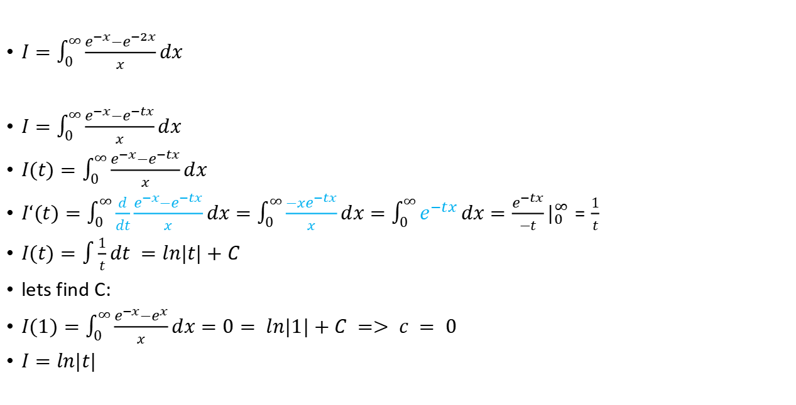
Substitute: $\frac{e^{−tx}}{x}$
$I=\int_{0}^{∞}{\frac{e^{−x}−e^{−2x}}{x}}dx$
$I=\int_{0}^{∞}{\frac{e^{−x}−e^{−tx}}{x}}dx$
$I(t)=\int_{0}^{∞}{\frac{e^{−x}−e^{−tx}}{x}}dx$
$I‘(t)=\int_{0}^{∞}{\frac{d}{dt}\frac{e^{−x}−e^{−tx}}{x}}dx=\int_{0}^{∞}{\frac{−xe^{−tx}}{x}}dx=\int_{0}^{∞}{e^{−tx}}dx=\frac{e^{−tx}}{−t}|_{0}^{∞}=\frac{1}{t}$
$I(t)=\int{\frac{1}{t}}dt =ln|t|+C$
lets find C:
$I(1)=\int_{0}^{∞}{\frac{e^{−x}−e^{x}}{x}}dx=0= ln|1|+C => c = 0$
$I=ln|t|$

Slide 4
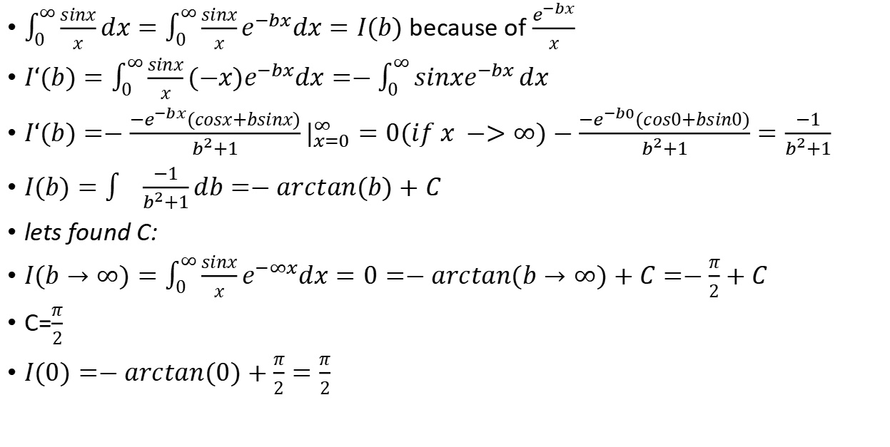
Trick $\frac{e^{−bx}}{x}$
$\int_{0}^{∞}{\frac{sinx}{x}}dx=\int_{0}^{∞}{\frac{sinx}{x}}e^{−bx}dx=I(b)$ because of $\frac{e^{−bx}}{x}$
$I‘(b)=\int_{0}^{∞}{\frac{sinx}{x}}{(−x)e}^{−bx}dx=−\int_{0}^{∞}{sinxe^{−bx}}dx$
$I‘(b)=−\frac{−e^{−bx}(cosx+bsinx)}{b^{2}+1}|_{x=0}^{∞}=0(if x −>∞)−\frac{−e^{−b0}(cos0+bsin0)}{b^{2}+1}=\frac{−1}{b^{2}+1}$
$I(b)=\int{\frac{−1}{b^{2}+1}}db=−arctan(b)+C$
lets found C:
$I(b→∞)=\int_{0}^{∞}{\frac{sinx}{x}}e^{−∞x}dx=0=−arctan(b→∞)+C=−\frac{π}{2}+C$
C=$\frac{π}{2}$
$I(0)=−arctan(0)+\frac{π}{2}=\frac{π}{2}$

Slide 5
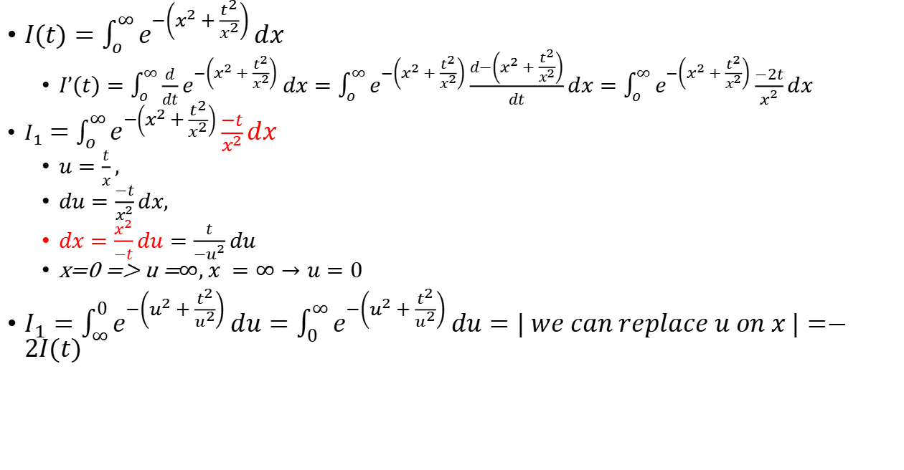
TO diff. eq
$I(t)=\int_{o}^{∞}{e^{−\left(x^{2}+\frac{t^{2}}{x^{2}}\right)}}dx$
$I’(t)=\int_{o}^{∞}{{\frac{d}{dt}e}^{−\left(x^{2}+\frac{t^{2}}{x^{2}}\right)}}dx=\int_{o}^{∞}{e^{−\left(x^{2}+\frac{t^{2}}{x^{2}}\right)}}\frac{d−\left(x^{2}+\frac{t^{2}}{x^{2}}\right)}{dt}dx=\int_{o}^{∞}{e^{−\left(x^{2}+\frac{t^{2}}{x^{2}}\right)}}\frac{−2t}{x^{2}}dx$
$I_{1}=\int_{o}^{∞}{e^{−\left(x^{2}+\frac{t^{2}}{x^{2}}\right)}}\frac{−t}{x^{2}}dx$
$u=\frac{t}{x},$
$du=\frac{−t}{x^{2}}dx,$
$dx=\frac{x^{2}}{−t}du=\frac{t}{−u^{2}}du$
x=0 => u =$∞, x =∞→u=0$
$I_{1}=\int_{∞}^{0}{e^{−\left(u^{2}+\frac{t^{2}}{u^{2}}\right)}}du=\int_{0}^{∞}{e^{−\left(u^{2}+\frac{t^{2}}{u^{2}}\right)}}du=| we can replace u on x |=−2I(t)$

Slide 6

TO diff. eq - 2
Solve differentioal equasion:
$I’(t)=$-2y(t)
$\frac{dy}{dx}=−2y,\frac{dy}{y}=−2dx,ln |y |=−2x+c,y={ce}^{−2x}$
find constant:
$I(t→0)=\int_{o}^{∞}{e^{−\left(x^{2}\right)}}dx=\frac{\sqrt{π}}{2}=c$
$I(t)=\int_{o}^{∞}{e^{−\left(x^{2}+\frac{t^{2}}{x^{2}}\right)}}dx={\frac{\sqrt{π}}{2}e}^{−2x}$

Slide 7

How to solve gaussian integral with feyman sub - TODO - solve
$I(t)=\int{e^{−tx^{2}}dx}$
$I‘(t)=−\int{{x^{2}e}^{−tx^{2}}dx}$
$du = {xe}^{−tx^{2}}dx dv = dx$
u = $−\frac{1}{t}e^{−tx^{2}} v = x$
$I‘(t)=\frac{x}{t}e^{−tx^{2}}−\frac{1}{t}I(t)$

Slide 8
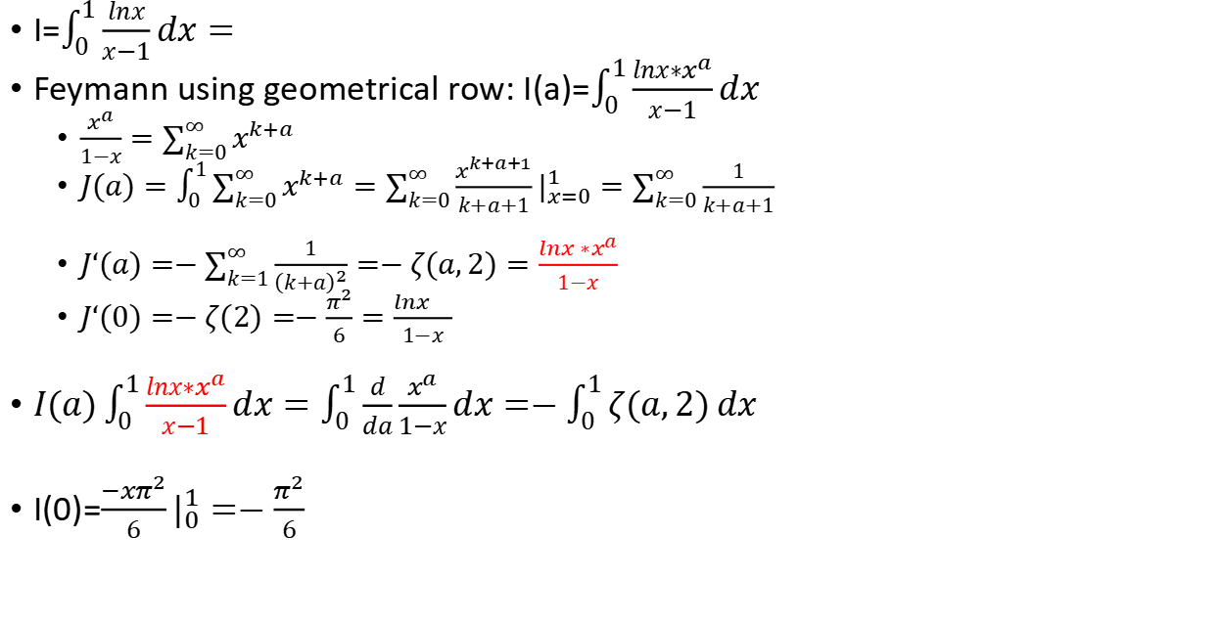
Trick $∗x^{a}$
I=$\int_{0}^{1}{\frac{lnx}{x−1}dx}=$
Feymann using geometrical row: I(a)=$\int_{0}^{1}{\frac{lnx∗x^{a}}{x−1}dx}$
$\frac{x^{a}}{1−x}=\sum_{k=0}^{∞}{x^{k+a}}$
$J(a)=\int_{0}^{1}{\sum_{k=0}^{∞}{x^{k+a}}}=\sum_{k=0}^{∞}{\frac{x^{k+a+1}}{k+a+1}}|_{x=0}^{1}=\sum_{k=0}^{∞}{\frac{1}{k+a+1}}$
$J‘(a)=−\sum_{k=1}^{∞}{\frac{1}{{\left(k+a\right)}^{2}}}=−ζ(a,2)=\frac{{lnx ∗x}^{a}}{1−x}$
$J‘(0)=−ζ(2)=−\frac{π^{2}}{6}=\frac{{lnx }^{}}{1−x}$
$I(a)\int_{0}^{1}{\frac{lnx∗x^{a}}{x−1}dx}=\int_{0}^{1}{\frac{d}{da}\frac{x^{a}}{1−x}dx}=−\int_{0}^{1}{ζ(a,2)}dx$
I(0)=$\frac{{−xπ}^{2}}{6}|_{0}^{1}=−\frac{π^{2}}{6}$

Slide 9

$\int_{0}^{π}{\frac{dx}{t+cos(x)}}−?$

Slide 10
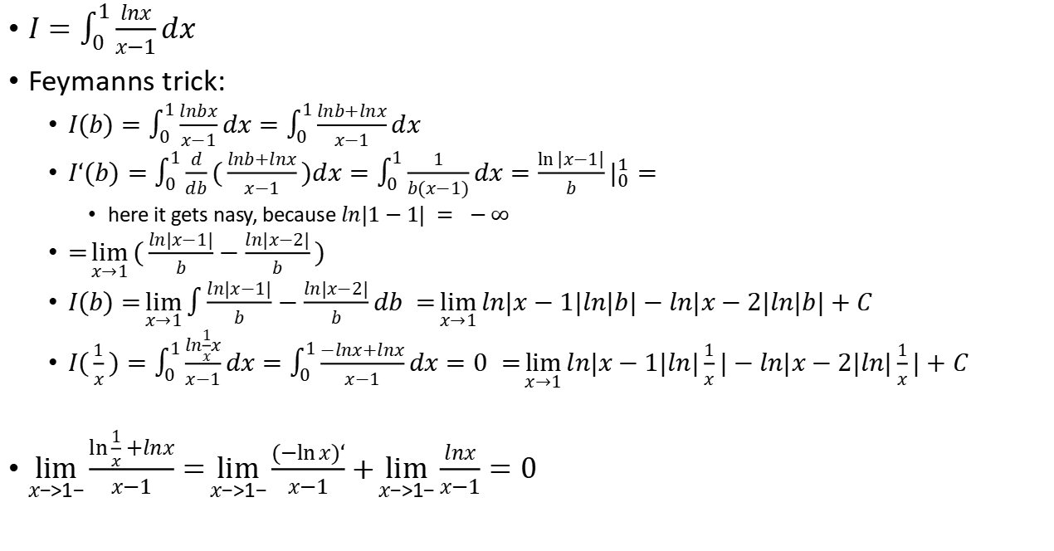
Not complete
$I=\int_{0}^{1}{\frac{lnx}{x−1}dx}$
Feymanns trick:
$I(b)=\int_{0}^{1}{\frac{lnbx}{x−1}dx=\int_{0}^{1}{\frac{lnb+lnx}{x−1}dx} }$
$I‘(b)=\int_{0}^{1}{\frac{d}{db}(\frac{lnb+lnx}{x−1})dx=\int_{0}^{1}{\frac{1}{b(x−1)}dx=\frac{\ln\left|x−1\right|}{b}}}|_{0}^{1}=$
here it gets nasy, because $ln|1−1| = −∞$
$=\lim_{x→1}{(\frac{ln|x−1|}{b}}−\frac{ln|x−2|}{b})$
$I(b)=\lim_{x→1}{\int{\frac{ln|x−1|}{b}}}−\frac{ln|x−2|}{b}db =\lim_{x→1}{ln|x−1|ln|b|−ln|x−2|ln|b|}+C$
$I(\frac{1}{x})=\int_{0}^{1}{\frac{ln\frac{1}{x}x}{x−1}dx=\int_{0}^{1}{\frac{−lnx+lnx}{x−1}dx}=0 }=\lim_{x→1}{ln|x−1|ln|\frac{1}{x}|−ln|x−2|ln|\frac{1}{x}|}+C$
$\lim_{x−>1−}{\frac{\ln{\frac{1}{x}+lnx}}{x−1}}=\lim_{x−>1−}{\frac{(−ln{x)‘}}{x−1}}+\lim_{x−>1−}{\frac{lnx}{x−1}}=0$

Slide 11

Feymanns integral
$I=\int_{0}^{∞}{\frac{dx}{1+x^{n}}}$
feymann step: $I(t)=\int_{0}^{∞}{\frac{e^{−t(1+x^{n})}}{1+x^{n}}}dx$
derivative inside an integral: ${J(t)= \left(I(t)\right)}^{‘t}=\int_{0}^{∞}{\frac{−(1+x^{n})e^{−t(1+x^{n})}}{1+x^{n}}}dx= \int_{0}^{∞}{e^{−t(1+x^{n})}}dx=−e^{−t}\int_{0}^{∞}{e^{−tx^{n}}}$dx
substitution: y = $tx^{n}$
$dy =ntx^{n−1}dx$
$x^{n}$ = $\frac{y}{t}$
x=$\sqrt[n]{\frac{y}{t}}$
$dy =nt\frac{y}{t}\sqrt[n]{\frac{t}{y}}dx$=$ny \sqrt[n]{\frac{t}{y}}dx$
$dx=\frac{1}{n}{t^{(−\frac{1}{n})}y}^{(\frac{1}{n}−1)}dy$
$J(t)=−e^{−t}{{\frac{1}{n}t}^{(−\frac{1}{n})}}^{}\int_{0}^{∞}{{y^{\left(\frac{1}{n}−1\right)}e}^{−y}}dy$ = -$e^{−t}\frac{1}{n}{t^{(−\frac{1}{n})}}^{}G(\frac{1}{n})$
$\int_{0}^{∞}{{\left(I(t)\right)}^{‘t}}$dt = $I(t→∞)−I(t→0)$
$I(t→∞)$= $\int_{0}^{∞}{\frac{e^{−∞(1+x^{n})}}{1+x^{n}}}dx=0$
I(0)= I=-$\int_{0}^{∞}{{\left(I(t)\right)}^{‘t}}$dt =$−\int_{0}^{∞}{−e^{−t}{t^{(−\frac{1}{n})}}^{}G(\frac{1}{n})}dt =\frac{1}{n}G(\frac{1}{n})\int_{0}^{∞}{e^{−t}{t^{(−\frac{1}{n})}}^{}}dt$=$\frac{1}{n}G(\frac{1}{n})G(1−\frac{1}{n})$
eulers reflection formula: G(z)-G(1-z)=$\frac{π}{\sin\left(πz\right)}$
I = $\frac{π}{\operatorname{nsin}\left(\frac{π}{n}\right)}$

